Slide 1

Dental/Chamber Management System
Comprehensive Overview & Architecture

Slide 2




Introduction: Streamlining Dental Practice Operations
This advanced Dental/Chamber Management System is meticulously designed to optimize the daily operations of modern dental practices. Our primary purpose is to facilitate efficient management, ensuring seamless workflows and enhanced patient care.
Efficient Management
Target Users
Centralized control over all aspects of practice administration, from appointments to billing.
Tailored for Administrators, Doctors, Receptionists, and Assistants, ensuring role-specific functionalities.
Key Features
A robust suite of tools including patient management, appointment scheduling, treatment tracking, billing, inventory, and comprehensive reports.

Slide 3





Secured Access: Roles and User Permissions
Our system employs a robust role-based access control mechanism to ensure data security and operational integrity. Each user role is assigned specific privileges, allowing access only to the functionalities and data relevant to their responsibilities.
Admin
Doctor
Full system oversight, configuration, and user management.
Access to patient records, treatment plans, and prescription management.
Receptionist
Assistant
Appointment scheduling, patient registration, and billing tasks.
Support for treatment procedures and inventory management.
Login via Phone Number: A secure and convenient authentication method.
Role-Based Access: Ensures that each user interacts only with the necessary components, enhancing security and reducing errors.

Slide 4








Core Modules: The Backbone of Your Practice
The system is built upon a foundation of interconnected modules, each designed to manage a critical aspect of dental practice operations. This integrated approach ensures comprehensive coverage and seamless data flow across the entire system.
Patient Management
Appointments
Comprehensive patient profiles, history, and communication logs for personalized care.
Efficient scheduling, reminders, and calendar integration to optimize clinic flow.
Treatments & Procedures
Prescriptions & Medical Files
Detailed tracking of all dental services, treatment plans, and progress notes.
Digital management of prescriptions and secure storage of all medical documents.
Billing & Payments
Lab Requests
Automated invoicing, payment processing, and financial transaction tracking.
Streamlined communication and tracking for all external laboratory services.
Inventory & Expenses
Reporting & Analytics
Real-time inventory levels, reorder alerts, and expense management for cost control.
Customizable reports and actionable insights for informed decision-making.

Slide 5

Database Design Overview: Relational Architecture
The system utilizes a robust relational database (MySQL/MariaDB) to ensure data integrity, scalability, and efficient retrieval. This architecture allows for complex relationships between different data entities, providing a comprehensive and interconnected view of your practice's operations.
Key Tables
Users: Stores user credentials and role assignments.
Roles: Defines access levels and permissions.
Patients: Contains all patient demographic and contact information.
Doctors: Details for all practicing dentists and specialists.
Appointments: Manages schedules, statuses, and patient linkages.
Treatments: Records details of all procedures performed.
Prescriptions: Tracks medication details and dosages.
Medicines: Inventory of available medications.
Invoices: Generates and manages billing statements.
Payments: Records all financial transactions and payment statuses.
Lab: Manages external lab requests and results.
Inventory: Tracks dental supplies and equipment.
Expenses: Records operational costs and expenditures.

Slide 6

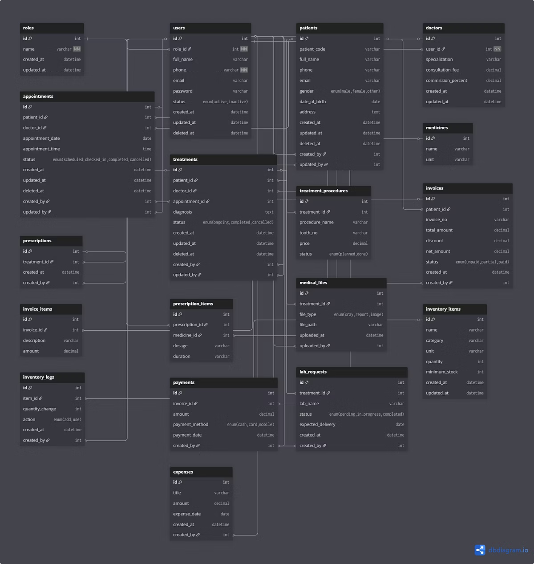
Entity-Relationship Diagram: Visualizing Data Connections
The ER Diagram below provides a visual representation of the database structure, illustrating how different entities are related and interact within the system. This comprehensive map is crucial for understanding data flow and maintaining database integrity.
This diagram highlights the primary keys, foreign keys, and the cardinality of relationships, ensuring a clear understanding of the data model.

Slide 7
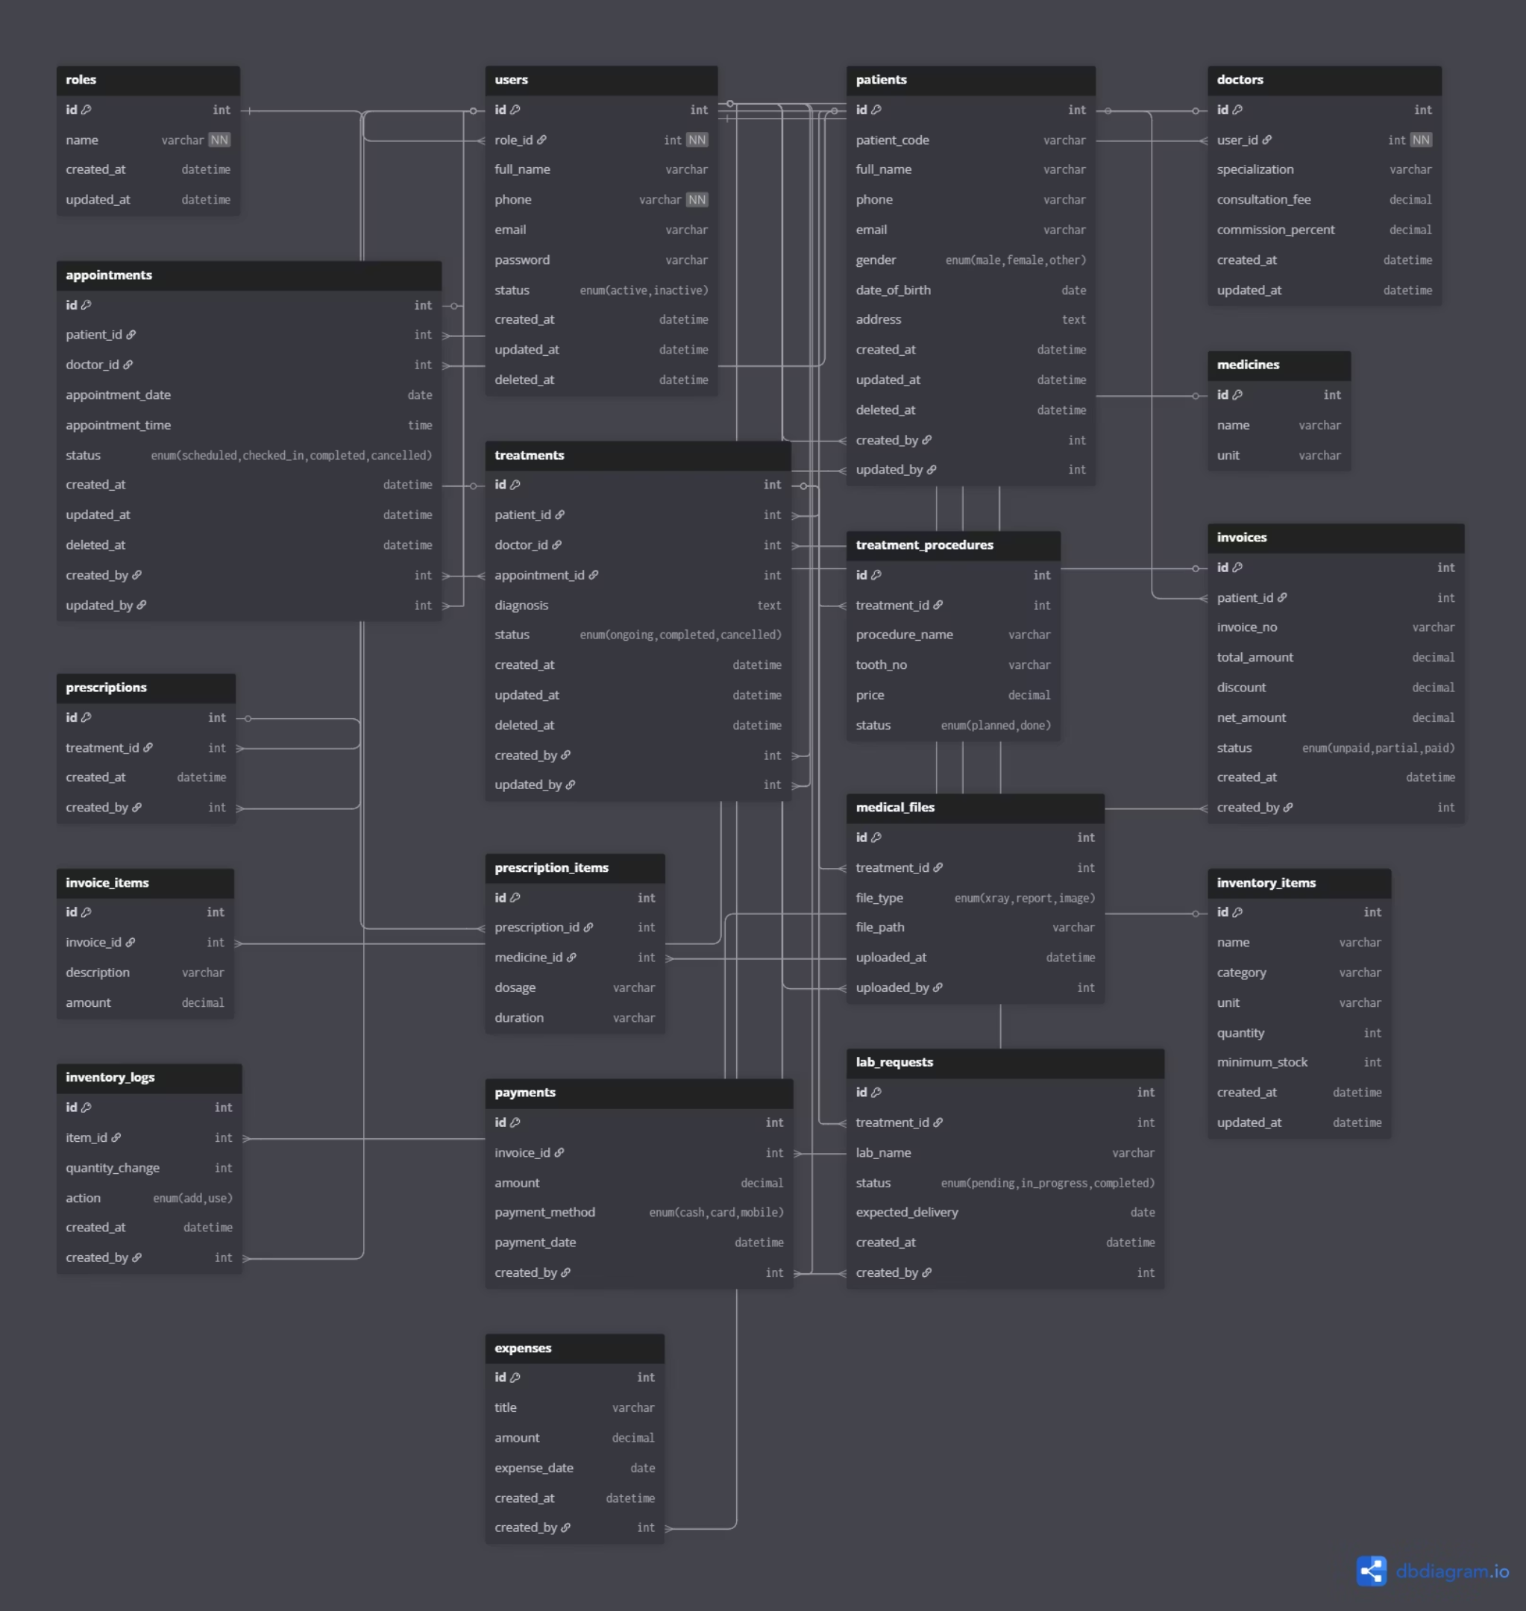

Slide 8
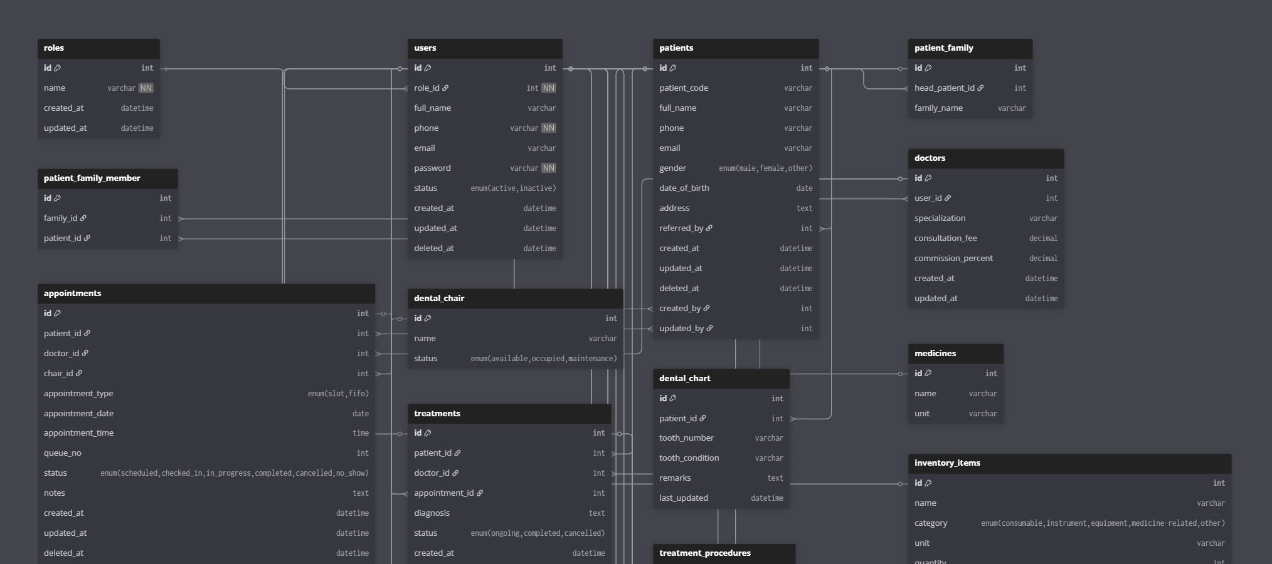

Slide 9
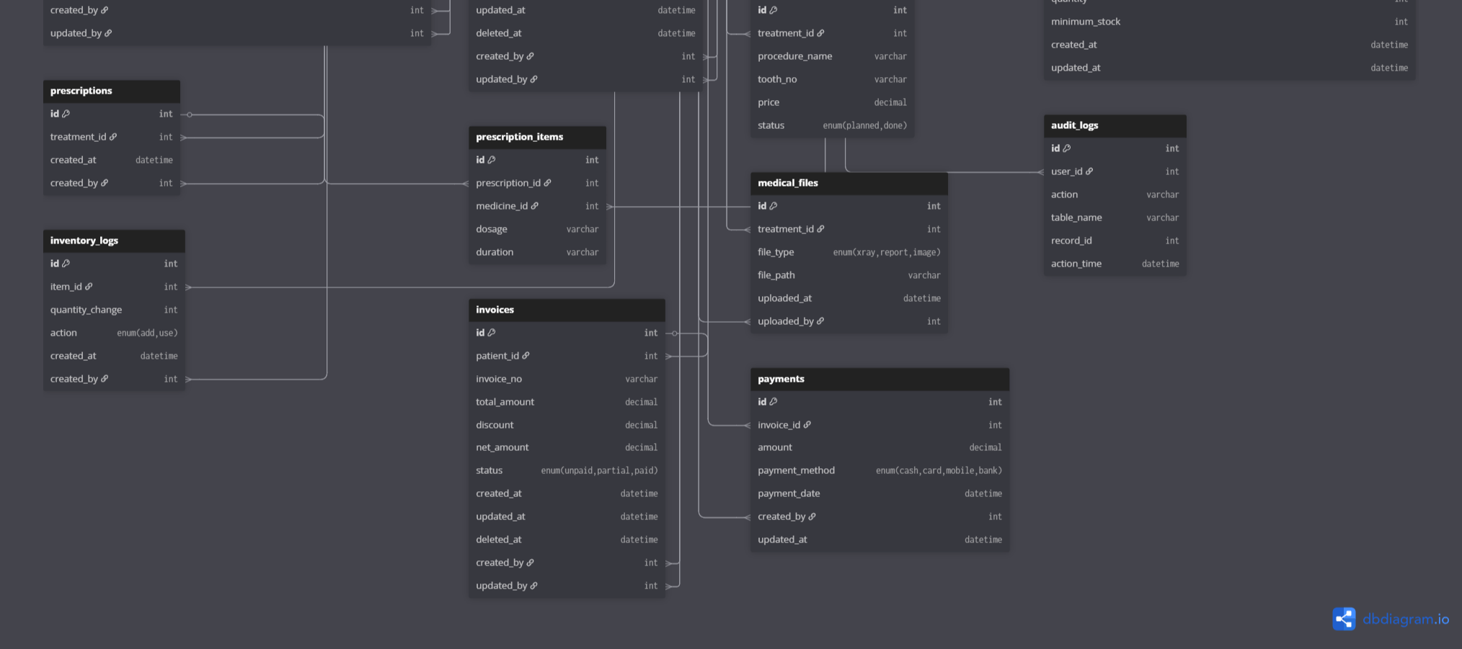

Slide 10






Appointment Flow: From Registration to Payment
Our system streamlines the entire patient journey, ensuring a smooth and efficient experience from the moment a patient registers until their payment is processed. This systematic approach minimizes wait times and enhances patient satisfaction.
Patient Registration
Quick and secure patient data entry and profile creation.
Appointment Scheduling
Easy booking, rescheduling, and automated reminders for both staff and patients.
Doctor Check-in
Doctors can quickly access patient details and appointment history.
Treatment Recording
Detailed capture of procedures, notes, and treatment progress.
Prescription & Lab Requests
Seamless generation of prescriptions and submission of lab requests.
Invoice & Payment
Automated billing and flexible payment processing.

Slide 11
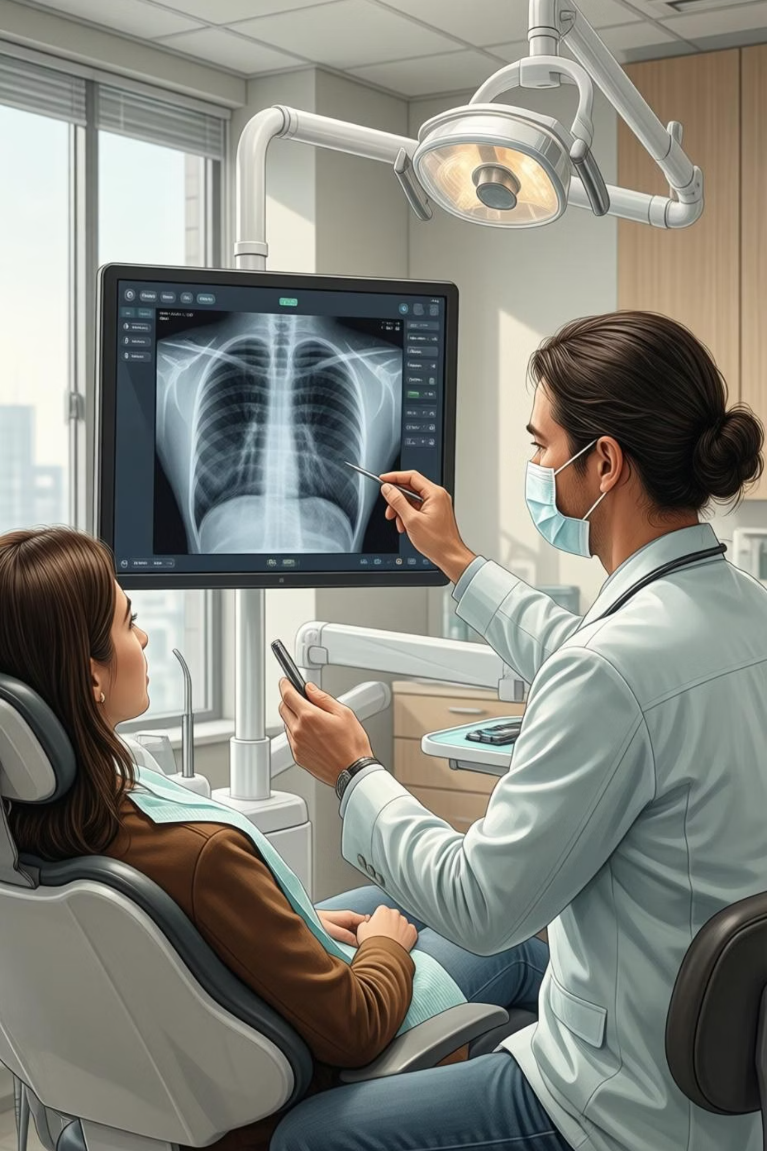
Treatment & Prescription Management
The system offers comprehensive tools for managing patient treatments and prescriptions. This module ensures that all aspects of patient care are meticulously recorded and easily accessible, supporting informed clinical decisions.
Treatment as Header
Each patient case is organized under a main treatment header, allowing for multiple associated procedures. This structure provides a clear overview of the entire treatment plan.
Prescription Linkage
All prescriptions are directly linked to the corresponding treatment, ensuring a complete medical record.
Medicine & Dosage Tracking
Detailed tracking of prescribed medications, dosages, and administration instructions.
Medical Files Integration
Securely attach and link all relevant medical files, such as X-rays, scans, and consent forms, to specific treatments.

Slide 12
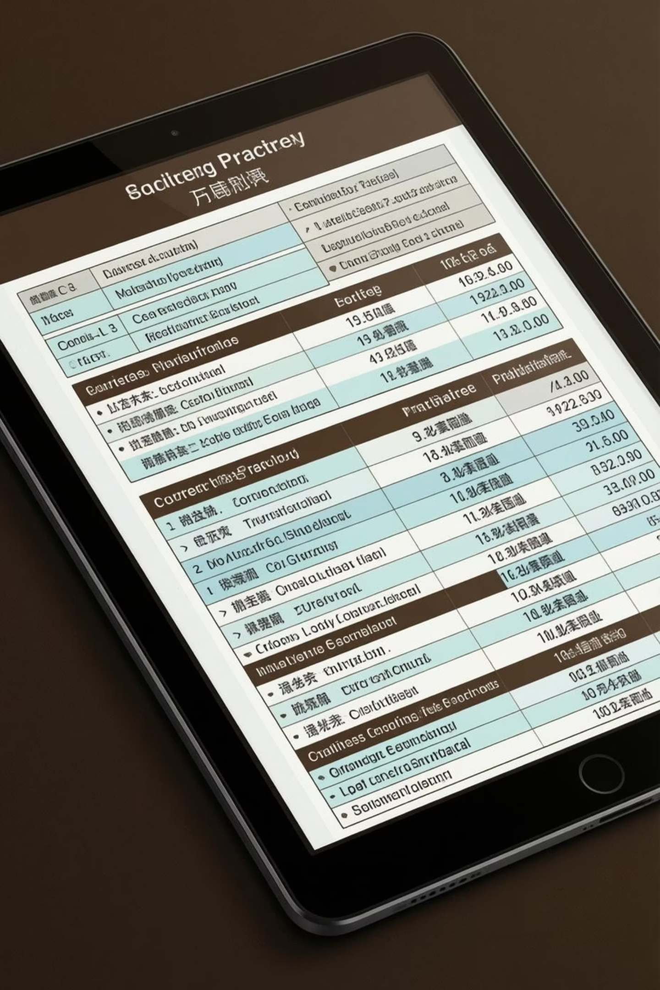




Billing & Payments: Financial Management
Our billing and payment module is designed to simplify financial operations for your dental practice. It provides robust tools for invoice generation, payment tracking, and revenue management, ensuring financial accuracy and transparency.
Invoices with Multiple Items
Generate detailed invoices that can include various procedures, medications, and services.
Payments Tracked Individually
Each payment is recorded separately, allowing for precise tracking and reconciliation.
Discounts & Partial Payments
The system supports the application of discounts and the processing of partial payments, offering flexibility to patients.
Revenue Tracking
Comprehensive tools to monitor and analyze revenue streams, aiding in financial planning.

Slide 13

Inventory & Expenses: Optimizing Resources
Effective management of inventory and expenses is crucial for the financial health of any dental practice. This module provides the tools necessary to track supplies, manage costs, and prevent stockouts, ensuring smooth operations and cost control.
1
2
3
4
Inventory Tracking
Minimum Stock Alerts
Expense Management
Comprehensive Reports
Real-time monitoring of all dental supplies and equipment with detailed logs.
Automated notifications when stock levels fall below predefined minimums, preventing shortages.
Categorize and track all operational expenses for better budget control.
Generate detailed reports on supply usage and overall costs for informed decision-making.

Slide 14
System Pages & Access Control
This overview details the primary modules and pages within the system, outlining their respective URL routes, allowed user roles, and core functionalities. This structured approach ensures clear navigation and robust access management across the application.
Page / Module
URL / Route
Roles Allowed
Notes
Dashboard
/dashboard
Admin, Doctor, Receptionist
Summary widgets (appointments, patients, revenue)
Login
/login
Public
Phone-based login
Patients
/patients
Admin, Doctor, Receptionist
Add / edit / view patient profiles
Patient Profile
/patients/{id}
Admin, Doctor, Receptionist
Show treatments, prescriptions, invoices
Doctors
/doctors
Admin
Add / edit / view doctors
Appointments
/appointments
Admin, Doctor, Receptionist
Schedule, check-in, complete appointments
Treatment Cases
/treatments
Admin, Doctor
Add procedures, diagnosis, prescription
Treatment Details
/treatments/{id}
Admin, Doctor
View / edit procedures, prescriptions, files
Prescriptions
/prescriptions
Admin, Doctor
Add / view prescriptions
Invoices
/invoices
Admin, Receptionist
Generate, view, record payments
Payments
/payments
Admin, Receptionist
Record payments against invoices
Lab Requests
/lab-requests
Admin, Doctor, Receptionist
Add / update status of lab requests
Inventory Items
/inventory
Admin, Assistant
Add / edit products and supplies
Inventory Logs
/inventory/logs
Admin, Assistant
Track usage / addition of inventory items
Expenses
/expenses
Admin
Track clinic operational expenses
Reports
/reports
Admin
Revenue, patient, inventory, treatment analytics
Profile / Settings
/profile
All logged in users
Update password / personal information

Slide 15
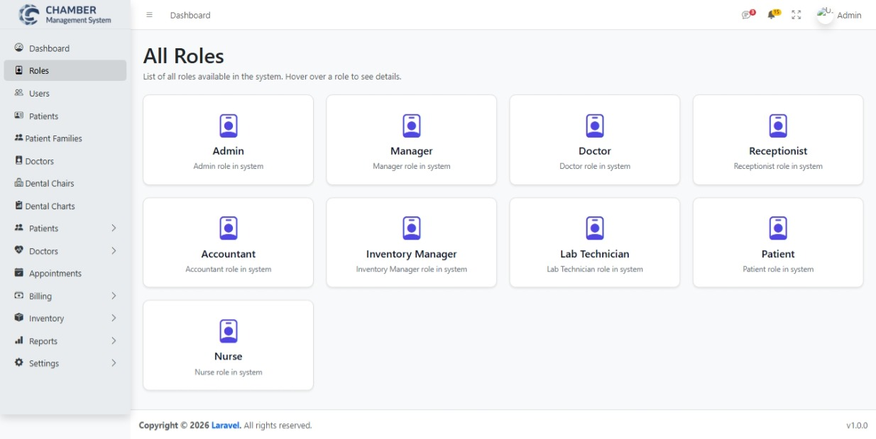
Roles Page

Slide 16
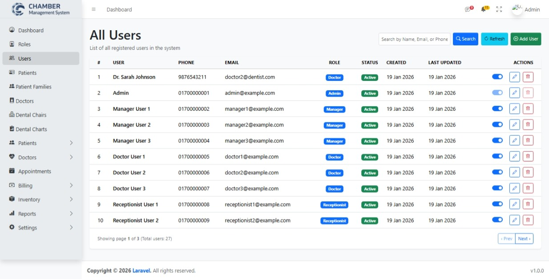
All Users Page

Slide 17
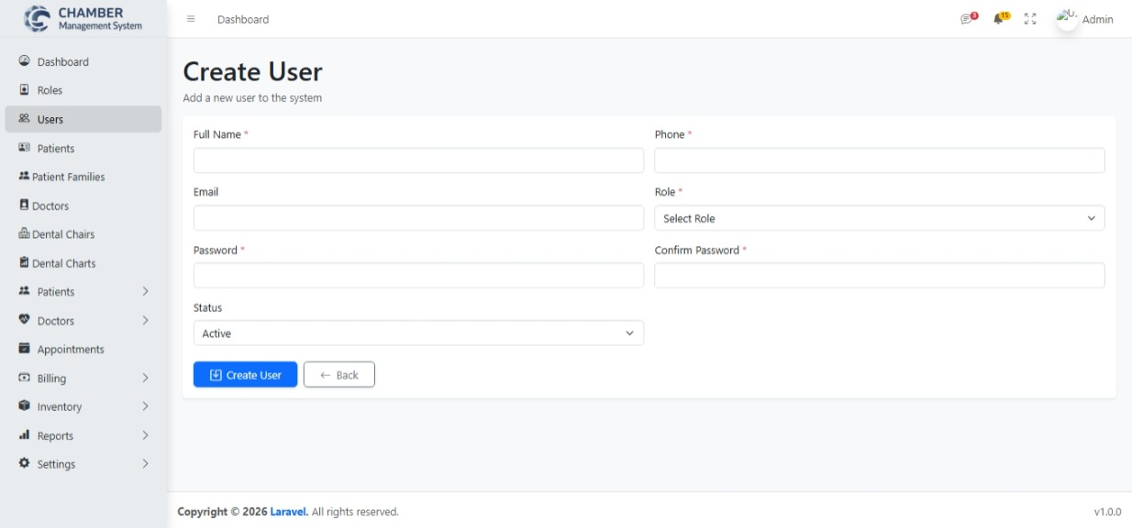
Create User Page

Slide 18
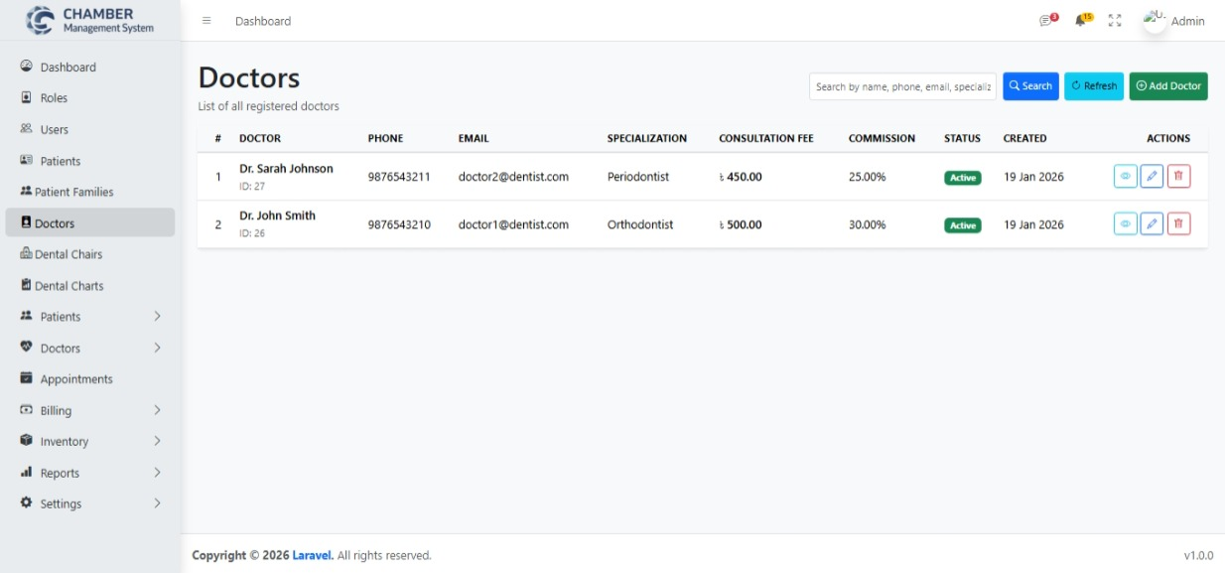
All Doctors Page

Slide 19
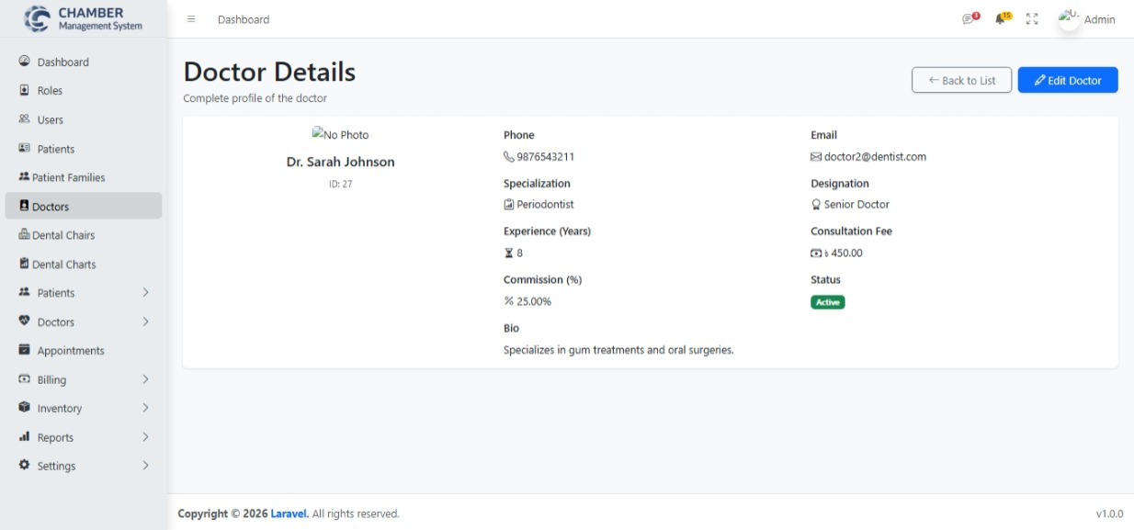
Doctor Details Page

Slide 20
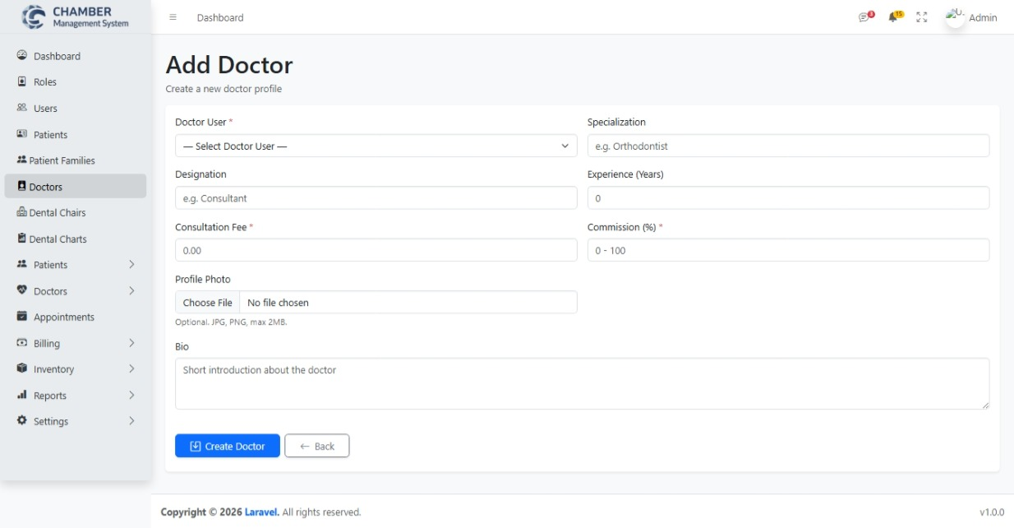
Add Doctor Page

Slide 21
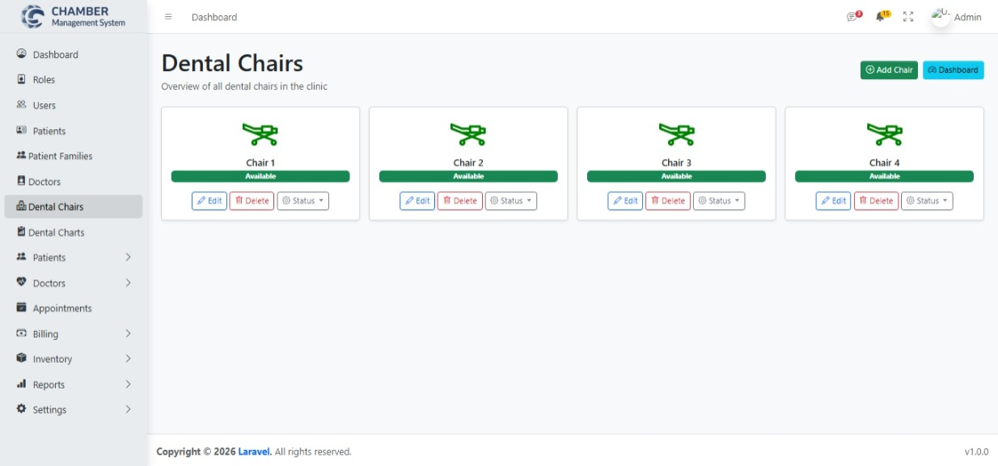
Dental chairs Page

Slide 22





Conclusion: Empowering Your Practice
The Dental/Chamber Management System is more than just software; it's a strategic partner designed to transform your practice. By integrating core functionalities into a seamless platform, it empowers you to achieve operational excellence, enhance patient experiences, and drive sustainable growth.
Streamlined Operations
Enhanced Patient Care
Automate daily tasks, minimize errors, and improve overall clinic efficiency across all departments.
Provide superior care through accurate records, precise treatment tracking, and personalized service.
Financial Clarity
Strategic Growth
Gain complete control over billing, payments, and expenses for robust financial health and improved profitability.
Leverage data-driven insights to make informed decisions, optimize resources, and secure the future success of your practice.

